Slide 2
Conflicts of Interest
Lab contract research: INSMED, Spero Therapeutics, RedHill Biopharma, AN2 Therapeutics, Paratek Pharmaceuticals, Mannkind Corporation
Research grants: Illumina

Slide 3
Learning objectives
Changes to mycobacterial nomenclature
Smear and culture methods for NTM
Methods of NTM identification
Methods for NTM susceptibility testing

Slide 4
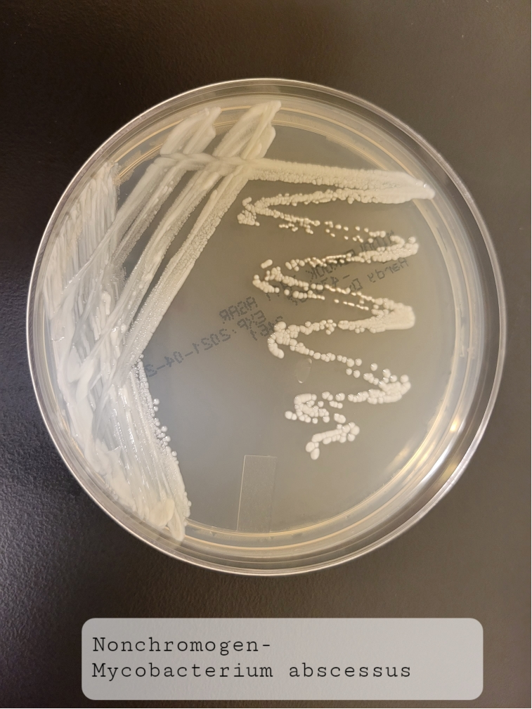
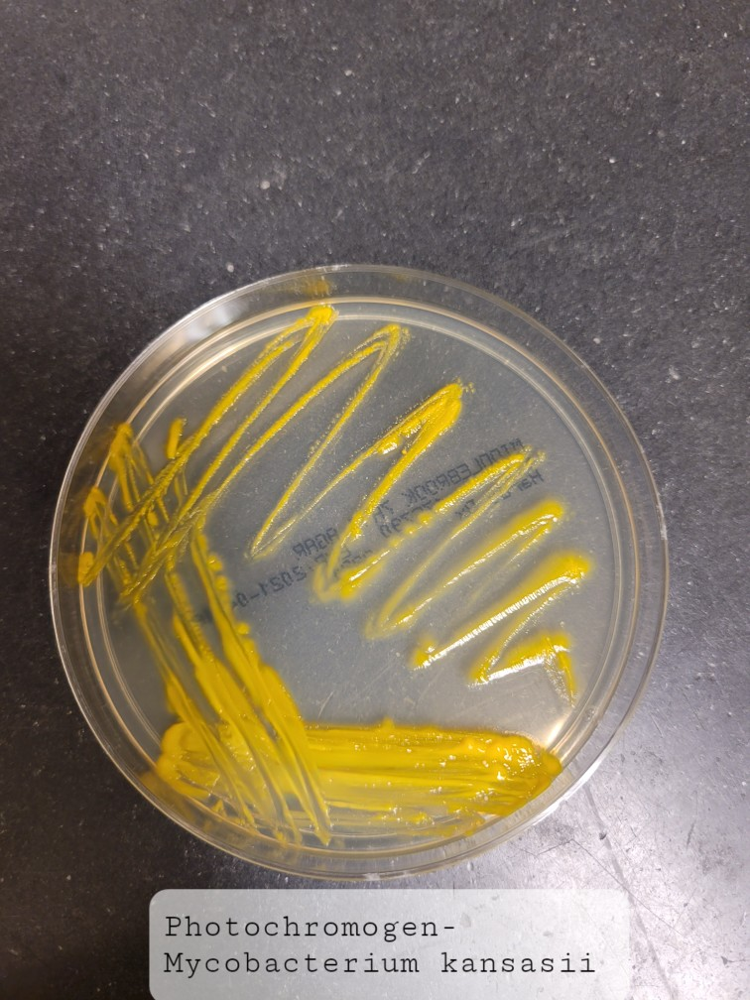
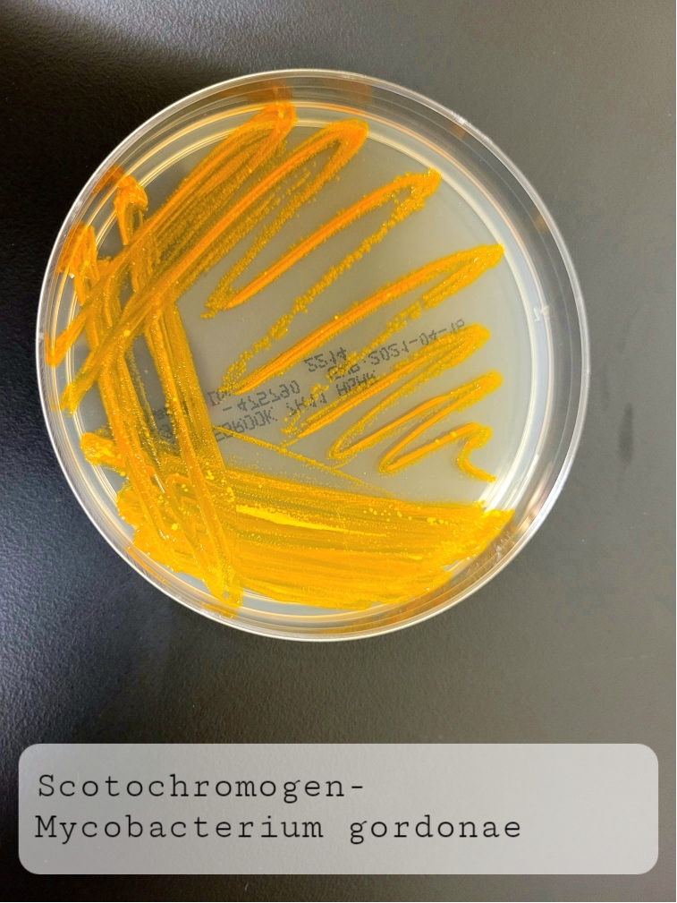
NJH
Classification and taxonomy
Non-tuberculous mycobacteria
NJH
Growth on solid agar within 7 days
Growth on solid agar after 7 days
Rapidly growing mycobacteria
(RGM)
Slowly growing mycobacteria
(SGM)
NJH
Runyoun classification:
Nonchromogens
Photochromogen
Scotochromogen

Slide 5
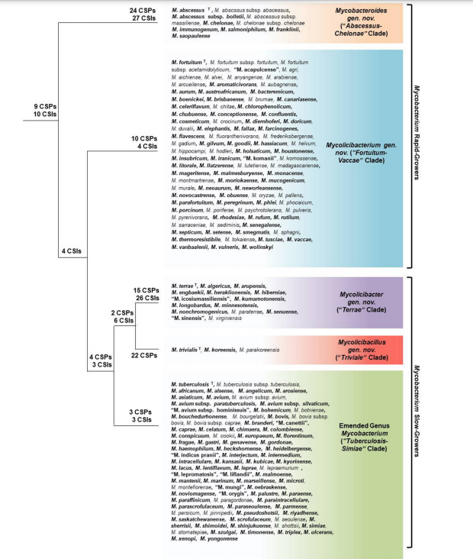
Gupta et al. Phylogenomics and Comparative Genomic Studies Robustly Support Division of the Genus Mycobacterium into an Emended Genus Mycobacterium and Four Novel Genera. Front Microbiol, 2018

Slide 6
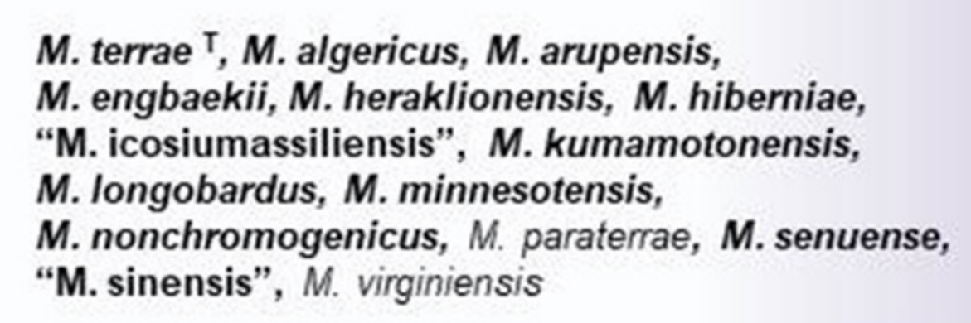
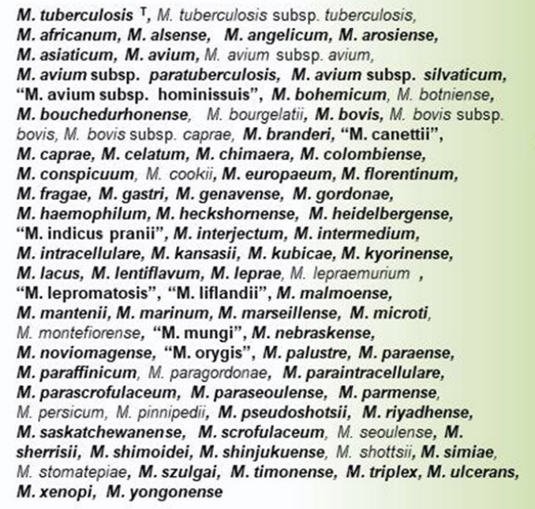
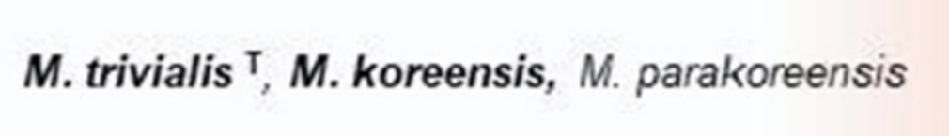

Slowly growing mycobacteria
(SGM)
Mycobacterium sp.
Mycolicibacter
Mycolicibacillus sp.
, M. vulneris

Slide 7
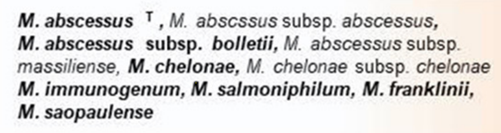
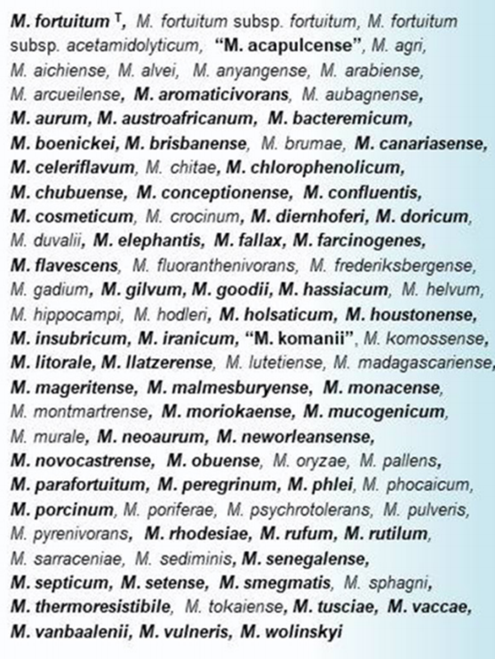
Rapidly growing mycobacteria
(RGM)
Mycobacteroides sp.
Mycolicibacterium sp.

Slide 8
General algorithm for testing mycobacteria in the lab
Suspicion of mycobacterial disease
Collect
samples
TB NAAT, if suspicious for TB
Smear
Culture
Identification
Susceptibilities

Slide 9
General algorithm for testing mycobacteria in the lab
Suspicion of mycobacterial disease
Collect
samples
TB NAAT, if suspicious for TB
Smear
Culture
Identification
Susceptibilities

Slide 10
Lab tests to detect mycobacteria
NTM exist naturally in the environment, especially water
NTM can be part of the normal flora¹
  Oral flora (likely transient) in 26-33% of people²
  Presence of NTM without progressive disease
Detection ≠ infection
¹ Thornton et al. The respiratory microbiome and nontuberculous mycobacteria: an emerging concern in human health. European Respiratory Review 2021 30: 200299
² Wali et al: The presence of atypical mycobacteria in the mouthwashes of normal subjects: role of tap water and oral hygiene. Ann Thorac Med 2008; 3: pp. 5-8

Slide 11
Specimen collection
Multiple sputum specimens
  Expectorated or induced
  Recommended: 5-10 ml¹
  Positivity over time²
  >= 2 sputum cultures positive is more likely to be clinically significant (as high as 98% agreement for clinically significant MAC)³
BALs/Bronchial washings may be more sensitive than sputum
Home sputum collection:

Slide 12
Home sputum collection
Allows patients to collect at home
Allows direct access to a full-service mycobacteriology lab
¹ Khare et al. Evaluation of Home Collected Sputum for Increased Access to High Quality Laboratory Testing of Nontuberculous Mycobacteria.. In progress, World Bronchiectasis Conference, NY, 2023

Slide 13
Sample Processing
Sterile tissues (e.g. biopsies)
Blood/Bone Marrow
Gastric lavage
Sterile fluids (e.g. CSF)
Nonsterile tissue (e.g. skin)
Sputum
Lyse blood cells
Neutralize
Concentrate, if possible
Grind
Digest
BAL/Wash
NO decontamination
Stool
Dilute
Concentrate
Decontaminate
Urine
Nonsterile body fluid
Concentrate & CaCl₂ treatment
Concentrate, if possible
Swabs
Routine contamination rate:
2-5% of solid cultures
7-8% of liquid cultures
2016. 7.2 General Mycobacterial Procedures, p.7.2.2.1-7.2.2.5. Leber AL Clinical Microbiology Procedures Handbook, 4th Edition. ASM Press, Washington, DC.

Slide 14
General algorithm for testing mycobacteria in the lab
Suspicion of mycobacterial disease
Collect
samples
TB NAAT, if suspicious for TB
Smear
Culture
Identification
Susceptibilities

Slide 15
General algorithm for testing mycobacteria in the lab
Suspicion of mycobacterial disease
Collect
samples
TB NAAT, if suspicious for TB
Potential TB or NTM (AFB1)
Smear
Culture
Identification
Susceptibilities
Potential NTM
(AFB3)

Slide 16
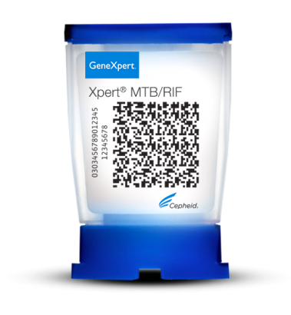
TB-NAAT assays from specimen
NAAT: nucleic acid amplification test
Lab developed tests
Cepheid Xpert MTB/Rif
  Real-time PCR
  Report and rifampin resistance
https://www.cepheid.com/en_US/tests/Critical-Infectious-Diseases/Xpert-MTB-RIF

Slide 17
 |  | Xpert MTB/RIF
Source | Population | Sensitivity (%) | Specificity (%)
Sputum/ Pulmonary | Adult | 85 (81 for HIV+) | 98
 | Children | 65 (72 for HIV+) | 99
Gastric aspirate | Children | 73 | 98-99
Pleural fluid | Adults | 50 | 99
Peritoneal fluid | Adults | 59 | 97
Cerebrospinal fluid | Adults | 70 | 97
Synovial fluid | Adults | 97 | 94
Lymph node aspirate | Adults | 89 | 86
Lymph node biopsy | Adults | 82 | 79
Urine | Adults | 85 | 97
 |  | Xpert MTB/RIF
Source | Population | Sensitivity (%) | Specificity (%)
Pulmonary | Adults | 96 | 98
Extrapulmonary | Adults | 96 | 99
¹Module 3: Diagnosis - Rapid diagnostics for tuberculosis detection. World Health Organization, Geneva, 2020
²Rowlinson, Musser, Khare. Mycobacterium tuberculosis Complex, Manual of Clinical Microbiology, 13th ed., in review, 2022

Slide 18
Which of the following is true about an NTM-NAAT from specimen?
A negative result can be used to diagnose disease
A positive result can represent contamination
The sensitivity is high
These are commonly offered tests

Slide 19
Which of the following is true about an NTM-NAAT from specimen?
A negative result can be used to diagnose disease
A positive result can represent normal flora
The sensitivity is high
These are commonly offered tests

Slide 20
General algorithm for testing mycobacteria in the lab
Suspicion of mycobacterial disease
“TB programmes should transition to replacing microscopy as the initial diagnostic test with molecular [WHO-endorsed rapid diagnostics] that allow for the detection of MTBC.”
Smears still helpful for NTM
Collect
samples
TB NAAT, if suspicious for TB
Smear
Culture
Identification
Susceptibilities

Slide 21
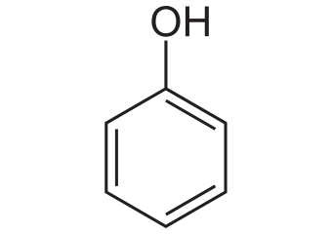

Primary Stain
Mordant
Decolorizer
Counterstain
Auramine rhodamine
Auramine-
rhodamine
0.5% acid-alcohol
Potassium permanganate
Kinyoun
Carbolfuchsin
Phenol
3% acid-alcohol
Methylene blue
Ziehl Neelsen
Carbolfuchsin
Heat
3% acid-alcohol
Methylene blue
Gram stain
Crystal violet
Iodine
Alcohol
Safranin

Slide 22
Primary Stain
Mordant
Decolorizer
Counterstain
Auramine rhodamine
Auramine-
rhodamine
0.5% acid-alcohol
Potassium permanganate
Kinyoun
Carbolfuchsin
Phenol
3% acid-alcohol
Methylene blue
Ziehl Neelsen
Carbolfuchsin
Heat
3% acid-alcohol
Methylene blue
Gram stain
Crystal violet
Iodine
Alcohol
Safranin

Slide 23
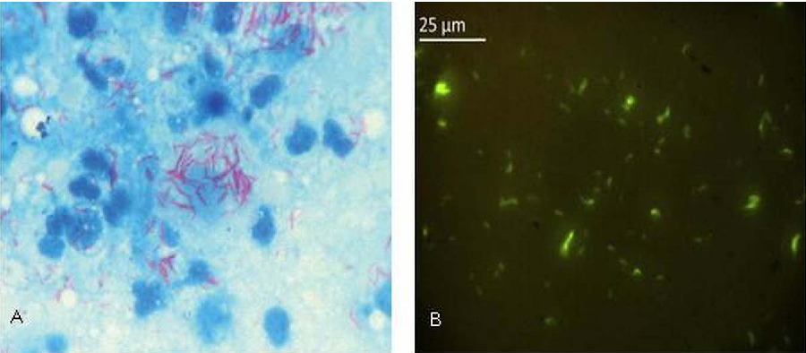
Ziehl-Neelsen
Auramine
O’Shea, Wilson. https://www.semanticscholar.org/paper/Tuberculosis-and-the-military.-O%E2%80%99Shea-Wilson/6a18505cd7cce1cbde4df1409085862d8a7cd376

Slide 24
AFB Smears
Ziehl Neelsen: sensitivity = 20-70%; need ~10⁴-10⁵ bacilli/ml
Auramine-rhodamine smears: ~5-10% more sensitive
Turnaround time: 24 hours
Somoskovi et al. https://www.ncbi.nlm.nih.gov/pmc/articles/PMC2925666/#R2
Cattamanchi et al. https://www.ncbi.nlm.nih.gov/pmc/articles/PMC2754584/
Singh, Parija. https://www.ncbi.nlm.nih.gov/pubmed/10772577
Azadi et al. https://www.ncbi.nlm.nih.gov/pmc/articles/PMC5897959/
Ghiasi et al. https://link.springer.com/article/10.1007/s40475-015-0043-1

Slide 25
Primary Stain
Mordant
Decolorizer
Counterstain
Auramine rhodamine
Auramine-
rhodamine
0.5% acid-alcohol
Potassium permanganate
Kinyoun
Carbolfuchsin
Phenol
3% acid-alcohol
Methylene blue
Ziehl Neelsen
Carbolfuchsin
Heat
3% acid-alcohol
Methylene blue
Gram stain
Crystal violet
Iodine
Alcohol
Safranin

Slide 26
General algorithm for testing mycobacteria in the lab
Suspicion of mycobacterial disease
Collect
samples
TB NAAT, if suspicious for TB
Smear
Culture
Identification
Susceptibilities

Slide 27
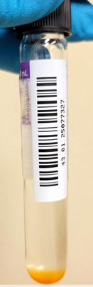
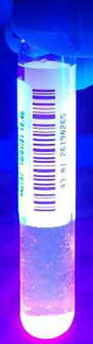
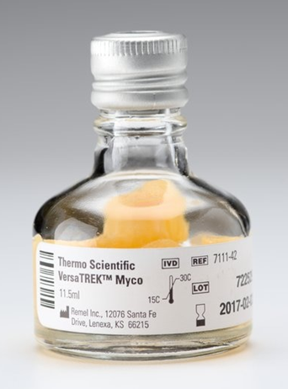
Culture techniques
VersaTREK Myco
MGIT tubes
Liquid cultures
  Supplements
    Sugars (dextrose or glucose)
    Oleic acid
    Catalase
  Antibiotic cocktails
  10-15% more sensitive than solid cultures.
  More rapid growth compared to solid culture
NJH
NJH
https://www.fishersci.com/shop/products/versatrek-myco-media-6/Y711142
Positive MGIT under UV
Positive MGIT

Slide 28
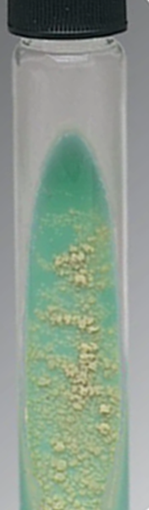
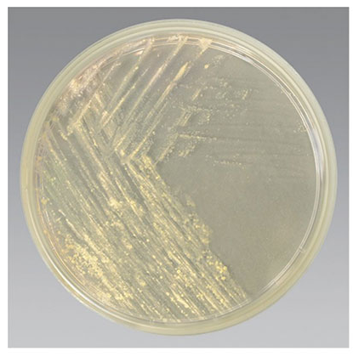
Culture techniques
LJ
Middlebrook 7H10 or 7H11
Solid culture
  Lowenstein Jensen agar
    contains egg and malachite green
  Middlebrook agar
    Contains casein hydrolysate (for MDR TB)
https://www.fishersci.ca/shop/products/lowenstein-jensen-medium-lj/p-4523753
https://www.fishersci.ca/shop/products/remel-middlebrook-7h11-agar/r01605

Slide 29
Culture conditions
Culture incubated for 6-8 weeks
Temperatures
  35-37ºC: routine
  42ºC: M. xenopi
  30-32ºC: M. marinum, M. haemophilum, M. ulcerans
Supplements:
  Hemin, ferric ammonium citrate – M. haemophilum
  Egg yolk – M. ulcerans
  Mycobactin J – M. genavense, M. avium subsp. paratuberculosis

Slide 30
General algorithm for testing mycobacteria in the lab
Suspicion of mycobacterial disease
Collect
samples
TB NAAT, if suspicious for TB
Smear
Culture
Identification
Susceptibilities

Slide 31
Identification techniques
MALDI-TOF mass spectrometry
PCR-based line probes
Sequencing

Slide 32
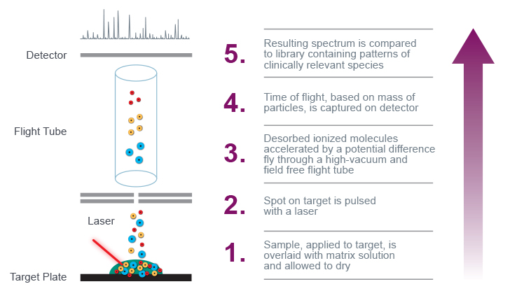
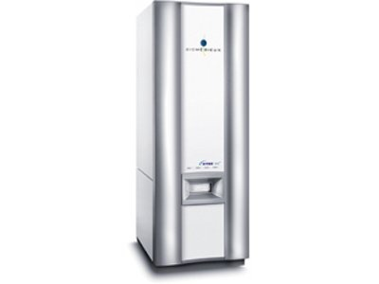
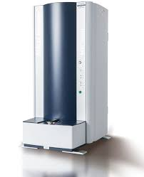
MALDI-TOF Mass Spectrometry
Bruker
Vitek
https://www.beckmancoulter.com/products/microbiology/maldi-tof-mass-spectrometry

Slide 33
Why differentiate within complexes and subspecies?
Different treatment patterns
Is prolonged positivity due to re-infection with a similar species?

Slide 34
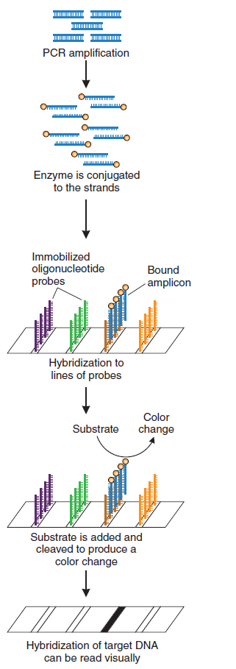
Line Probe Assays (LPA)
Step 1: PCR
Step 2: Amplicons are bound onto a membrane containing capture probes for identification and drug resistance genes
Step 3: Pattern of binding is read
Khare. Guide to clinical and Diagnostic Virology, 2019

Slide 35
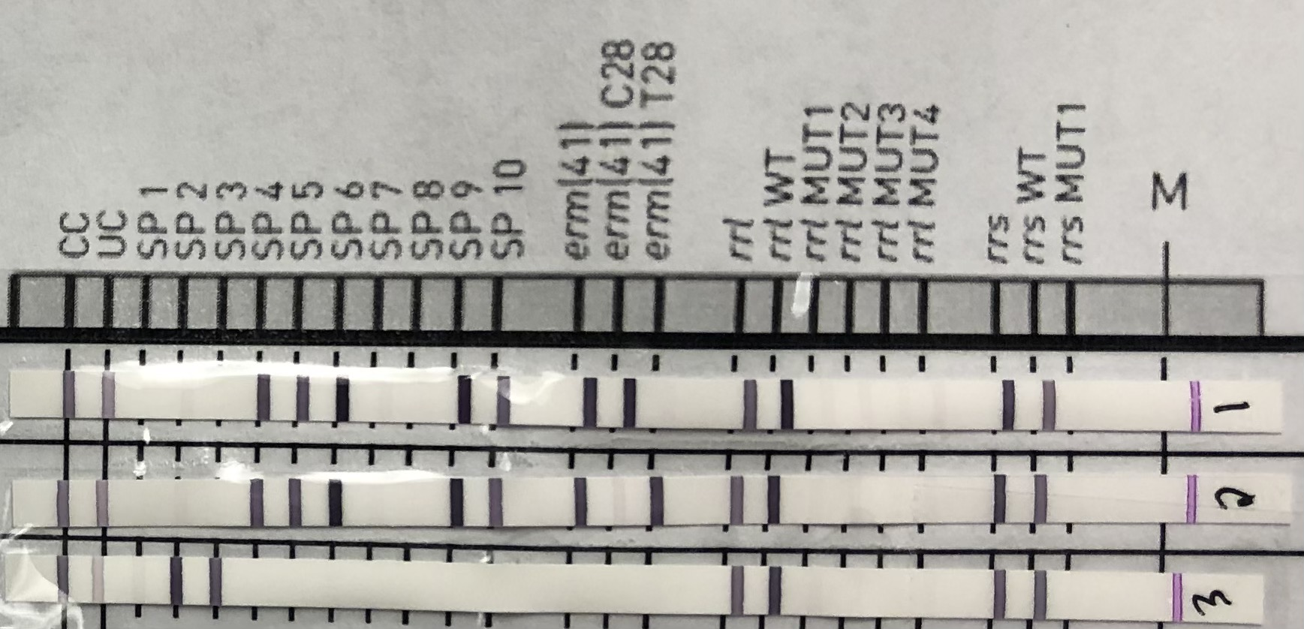
LPA results
S
M. abscessus subsp. abscessus
R
M. abscessus subsp. abscessus
M. intracellulare subsp. chimaera

Slide 36
Sanger Sequencing
Step 1: amplify a target gene
  Most common gene for identification
    rpoB – encodes subunit of bacterial RNA polymerase¹
    16S –rDNA encoding the 30S ribosomal rRNA
    16S-23S ITS – intergenic spacer region
    hsp65 – encodes a bacterial heat shock protein
Step 2: sequence the amplified gene
Step 3: compare the sequence to a database
Simmon et al. Simultaneous Sequence Analysis of the 16S rRNA and rpoB Genes by Use of RipSeq Software To Identify Mycobacterium Species. JCM, 2010

Slide 37
Most common organisms seen in our lab (2020-2021, inclusive)

Slide 38
General algorithm for testing mycobacteria in the lab
Suspicion of mycobacterial disease
Collect
samples
TB NAAT, if suspicious for TB
Smear
Culture
Identification
Susceptibilities

Slide 39
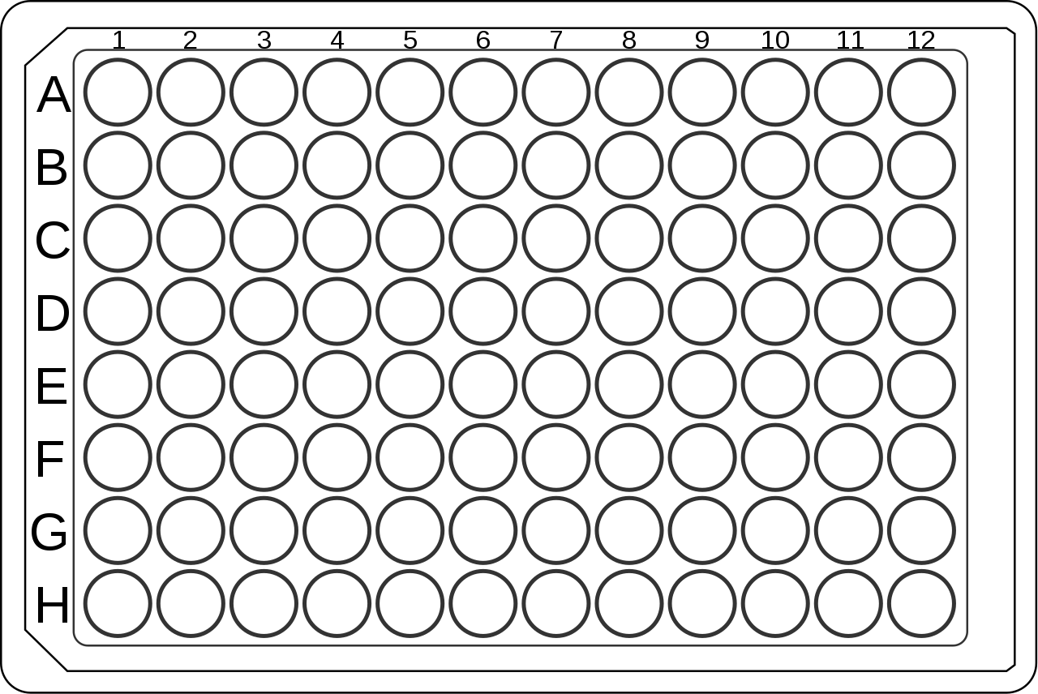
Antibiotic susceptibility testing (AST)
Broth microdilution testing
CLR
0.5 ug/ml
1 ug/ml
2 ug/ml
4 ug/ml
8 ug/ml
MIC
16 ug/ml
32 ug/ml
64 ug/ml

Slide 40
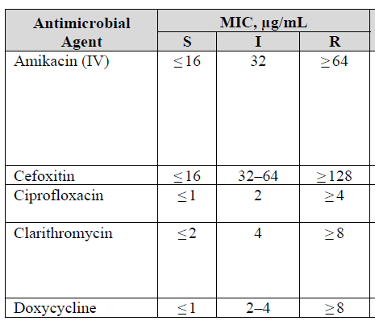
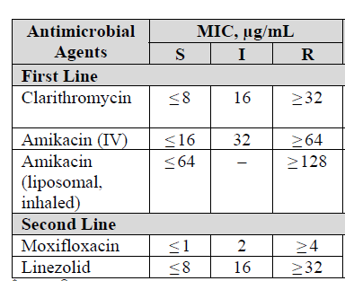
AST Interpretation
Minimum Inhibitory concentration = MIC value
Interpretation
    S, I, R = Susceptible, Intermediate, Resistant
    Defined by CLSI M62, 2018
Rapid growingly mycobacteria
MAC

Slide 41
Antibiotic susceptibility testing (AST)
Read manually (subjective, labor intensive)
Technically challenging
  Uneven growth
  trailing endpoints
  clumping, buttons vs. turbidity; Trimethoprim/sulfamethoxazole is read at 80% inhibition
CLR
0.5 ug/ml
1 ug/ml
2 ug/ml
4 ug/ml
8 ug/ml
MIC
16 ug/ml
32 ug/ml
64 ug/ml

Slide 42

Turnaround time
Slow growers:
  read at 7-14 days
  Fastidious species at 3-4 weeks
  M. genavense: Requires acid pH and mycobactin J supplementation; At least 6 weeks of incubation; long incubation time may cause antimicrobial degradation
Rapid growers:
  Most drugs read at 3-5 days
  Clarithromycin: read at 14 days (because of inducible resistance)
Other factors
  Insufficient growth? Needs subculture
  Mixed culture? Needs re-isolation

Slide 43
Molecular AST for NTM
Common NTM | Relevant Drug Markers
M. abscessus subsp. abscessus | erm(41), ~70% rrl, rrs
M. abscessus subsp. bolletii | erm(41), ~100% rrl, rrs
M. abscessus subsp. massiliense | rrl, rrs
M. avium sensu stricto | rrl, rrs
M. intracellulare subsp. chimaera | rrl, rrs
M. avium complex | rrl, rrs
M. chelonae | rrl, rrs
M. kansasii | N/A
M. fortuitum | erm(39)
erm(41): functional erythromycin ribosomal methylase causes inducible macrolide resistance
rrl: Mutations in the 23S rRNA (A2058G or A2059G) peptidyl transferase represents acquired (constitutive) macrolide resistance
rrs: specific mutations in the 16S ribosomal RNA represent constitutive aminoglycoside resistance

Slide 44
CLSI Breakpoints for NTM
Rapid growers
Slow growers
Antimicrobial | MIC (µg/mL)
 | Susceptible | Intermediate | Resistant
Amikacin | ≤16 | 32 | ≥64
Cefoxitin | 16 | 32-64 | ≥128
Clarithromycin | ≤4 | 8 | ≥16
Ciprofloxacin | ≤1 | 2 | ≥4
Doxycycline | ≤1 | 2-4 | ≥8
Imipenem | ≤4 | 8-16 | ≥32
Linezolid | ≤8 | 16 | ≥32
Minocycline | ≤1 | 2-4 | ≥8
Meropenem | ≤4 | 8-16 | ≥32
Moxifloxacin | ≤1 | 2 | ≥4
Linezolid | ≤8 | 16 | ≥32
Tigecycline | None, report MIC only
Tobramycin | ≤2 | 4 | ≥8
Trimethoprim/ sulfamethoxazole | ≤2/38 | - | ≥4/76
Antimicrobial | MIC (µg/mL)
 | Susceptible | Intermediate | Resistant
Amikacin (Intravenous) | ≤16 | 32 | ≥64
Amikacin (Inhaled, liposomal) | ≤16 | 32 | ≥128
Clarithromycin | ≤8 | 16 | ≥32
Ciprofloxacin | ≤1 | 2 | ≥4
Doxycycline | ≤1 | 2-4 | ≥8
Linezolid | ≤8 | 16 | ≥32
Minocycline | ≤1 | 2-4 | ≥8
Moxifloxacin | ≤1 | 2 | ≥4
Rifabutin | ≤2 | - | ≥4
Rifampin | ≤1 | - | ≥2
Trimethoprim/ sulfamethoxazole | ≤2/38 | - | ≥4/76
Khare, Elliot. Culture, Identification and Antimicrobial Susceptibility Testing of Nontuberculous Mycobacteria. Clinics in Chest Medicine, In preparation, 2023

Slide 45
CLSI Breakpoints for NTM
Amikacin has different formulations and breakpoints for MAC
Rapid growers
Slow growers
Antimicrobial | MIC (µg/mL)
 | Susceptible | Intermediate | Resistant
Amikacin | ≤16 | 32 | ≥64
Cefoxitin | 16 | 32-64 | ≥128
Clarithromycin | ≤4 | 8 | ≥16
Ciprofloxacin | ≤1 | 2 | ≥4
Doxycycline | ≤1 | 2-4 | ≥8
Imipenem | ≤4 | 8-16 | ≥32
Linezolid | ≤8 | 16 | ≥32
Minocycline | ≤1 | 2-4 | ≥8
Meropenem | ≤4 | 8-16 | ≥32
Moxifloxacin | ≤1 | 2 | ≥4
Linezolid | ≤8 | 16 | ≥32
Tigecycline | None, report MIC only
Tobramycin | ≤2 | 4 | ≥8
Trimethoprim/ sulfamethoxazole | ≤2/38 | - | ≥4/76
Antimicrobial | MIC (µg/mL)
 | Susceptible | Intermediate | Resistant
Amikacin (Intravenous) | ≤16 | 32 | ≥64
Amikacin (Inhaled, liposomal) | ≤16 | 32 | ≥128
Clarithromycin | ≤8 | 16 | ≥32
Ciprofloxacin | ≤1 | 2 | ≥4
Doxycycline | ≤1 | 2-4 | ≥8
Linezolid | ≤8 | 16 | ≥32
Minocycline | ≤1 | 2-4 | ≥8
Moxifloxacin | ≤1 | 2 | ≥4
Rifabutin | ≤2 | - | ≥4
Rifampin | ≤1 | - | ≥2
Trimethoprim/ sulfamethoxazole | ≤2/38 | - | ≥4/76
Khare, Elliot. Culture, Identification and Antimicrobial Susceptibility Testing of Nontuberculous Mycobacteria. Clinics in Chest Medicine, In preparation, 2023

Slide 46
CLSI Breakpoints for NTM
Amikacin has different formulations and breakpoints for MAC
Rapid growers
Slow growers
Antimicrobial | MIC (µg/mL)
 | Susceptible | Intermediate | Resistant
Amikacin | ≤16 | 32 | ≥64
Cefoxitin | 16 | 32-64 | ≥128
Clarithromycin | ≤4 | 8 | ≥16
Ciprofloxacin | ≤1 | 2 | ≥4
Doxycycline | ≤1 | 2-4 | ≥8
Imipenem | ≤4 | 8-16 | ≥32
Linezolid | ≤8 | 16 | ≥32
Minocycline | ≤1 | 2-4 | ≥8
Meropenem | ≤4 | 8-16 | ≥32
Moxifloxacin | ≤1 | 2 | ≥4
Linezolid | ≤8 | 16 | ≥32
Tigecycline | None, report MIC only
Tobramycin | ≤2 | 4 | ≥8
Trimethoprim/ sulfamethoxazole | ≤2/38 | - | ≥4/76
Antimicrobial | MIC (µg/mL)
 | Susceptible | Intermediate | Resistant
Amikacin (Intravenous) | ≤16 | 32 | ≥64
Amikacin (Inhaled, liposomal) | ≤16 | 32 | ≥128
Clarithromycin | ≤8 | 16 | ≥32
Ciprofloxacin | ≤1 | 2 | ≥4
Doxycycline | ≤1 | 2-4 | ≥8
Linezolid | ≤8 | 16 | ≥32
Minocycline | ≤1 | 2-4 | ≥8
Moxifloxacin | ≤1 | 2 | ≥4
Rifabutin | ≤2 | - | ≥4
Rifampin | ≤1 | - | ≥2
Trimethoprim/ sulfamethoxazole | ≤2/38 | - | ≥4/76
Khare, Elliot. Culture, Identification and Antimicrobial Susceptibility Testing of Nontuberculous Mycobacteria. Clinics in Chest Medicine, In preparation, 2023

Slide 47
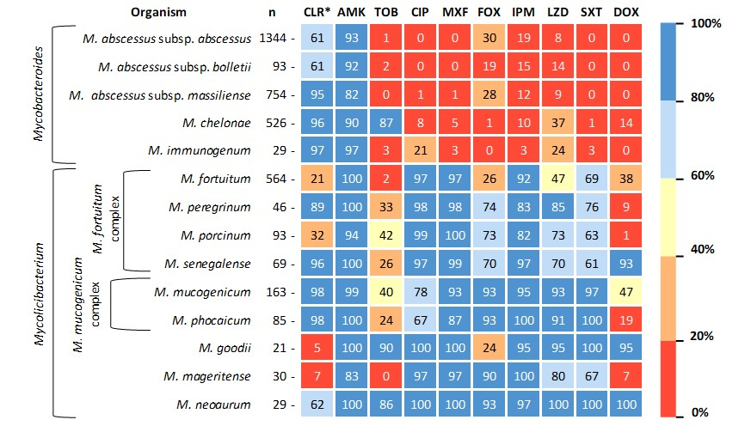
RGM Antibiogram
Hunkins, Calado, Daley, Khare. In vitro Susceptibility Patterns for Rapidly Growing Nontuberculous Mycobacteria in the United States, DMID, 2022

Slide 48
SGM Antibiogram
ETH
In preparation: Calado, Nguyen, Daley, Khare, 2023

Slide 49
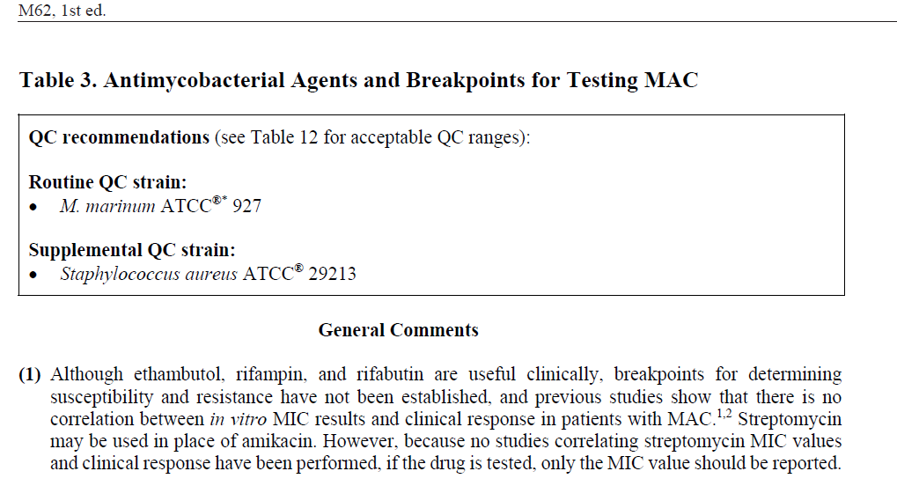
Rifampin and Ethambutol
M62, 1st ed. Performance Standards for Susceptibility Testing of Mycobacteria, Nocardia spp. and other Aerobic Actinomycetes. CLSI

Slide 50
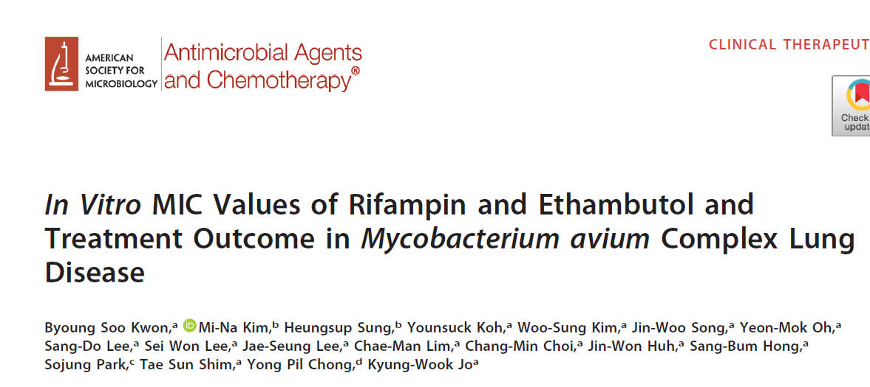
Rifampin and Ethambutol
2018
“These findings suggest that the in vitro MICs
of rifampin and ethambutol may be related to treatment outcome in MAC-LD.”

Slide 51
New drugs with potential activity against mycobacteria
 | Drug class | RGM | SGM | MTBC
Omadacycline | Tetracycline | Potential | Modest
Eravacycline | Tetracycline | Potential | Potential
Fobrepodacin | Amino-benzimidazole | Modest | Potential
Bedaquiline | Diaryl-quinolone | Potential | Potential | Yes
Tedizolid | Oxazolidinone | Potential | Potential
Delaminid | Nitroimidazole | No | Potential
Pretomanid | Nitroimidazole | No | No, except M. kansasii | Yes

Slide 52
In Summary…
Updates to nomenclature
Identification techniques
Antimicrobial susceptibility testing
  Phenotypic testing
  Genotypic testing
Guidelines

Slide 53
Questions?

