Slide 1

University of Colorado School of Medicine/
National Jewish Health (Adult) Program

Slide 2
Fellowship Program Information
1
2
Clinical Training
3
Living in Denver
History of the Program
Our two institutions
Research Training
Notes:
This is another option for an Overview slide.

Slide 3
History of the Program
Early History
1959: Formal post-doctoral training in Allergy and Clinical Immunology begins in Denver, at the University of Colorado.
1967: A pediatric fellowship training program is formed at National Jewish Health
1969: An adult fellowship training program is formed at National Jewish Health.
1970’s: Fitzsimmons Army Medical Center and CARIH (Children’s Asthma Research Institute and Hospital) form programs as well – total number of fellows at a given time in Denver was 29!
Notes:
Summarize presentation content by restating the important points from the lessons.
What do you want the audience to remember when they leave your presentation?
Save your presentation to a video for easy distribution (To create a video, click the File tab, and then click Share. Under File Types, click Create a Video.)

Slide 4
History of the Program
Modern History
1981: University of Colorado program and National Jewish Health program merge into a single adult training program.
Between the UCH/NJH adult program, the NJH pediatrics program, and the Children’s Hospital program, there will be 15-16 fellows in Denver at any given time.
Continuous ACGME Accreditation Since February 24,1982.
129 Fellows have Graduated from this Program Since 1982.
Notes:
Summarize presentation content by restating the important points from the lessons.
What do you want the audience to remember when they leave your presentation?
Save your presentation to a video for easy distribution (To create a video, click the File tab, and then click Share. Under File Types, click Create a Video.)

Slide 5
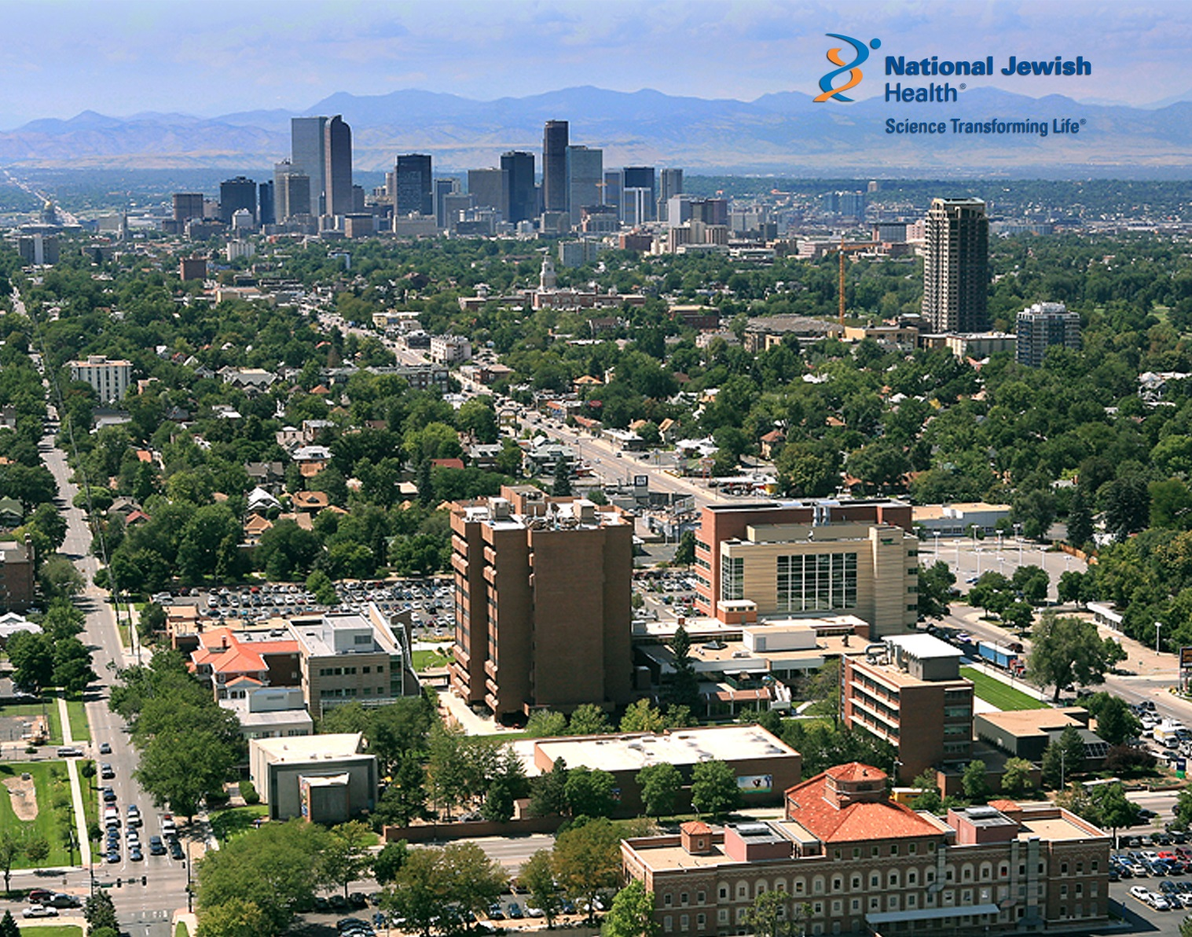
National Jewish Health

Slide 6
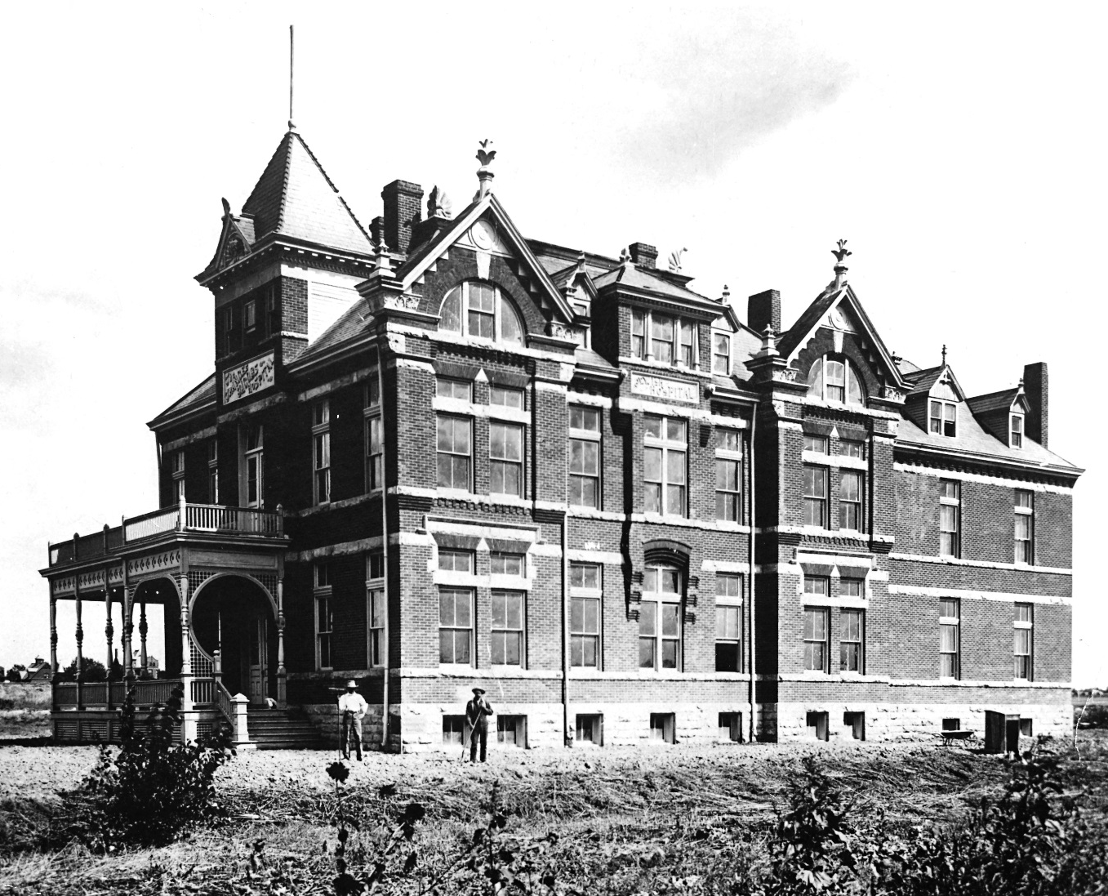
National Jewish Health: History
The National Jewish Hospital for Consumptives opened in 1899

Slide 7
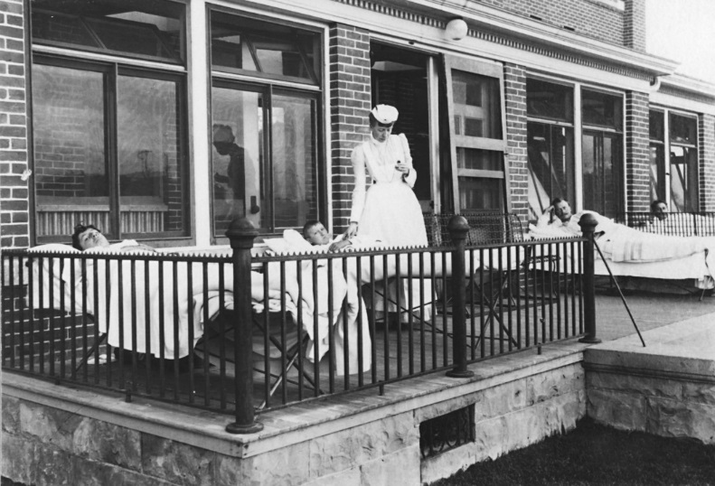
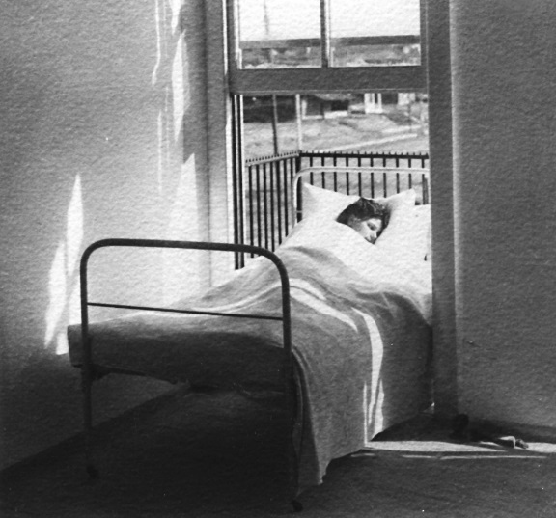
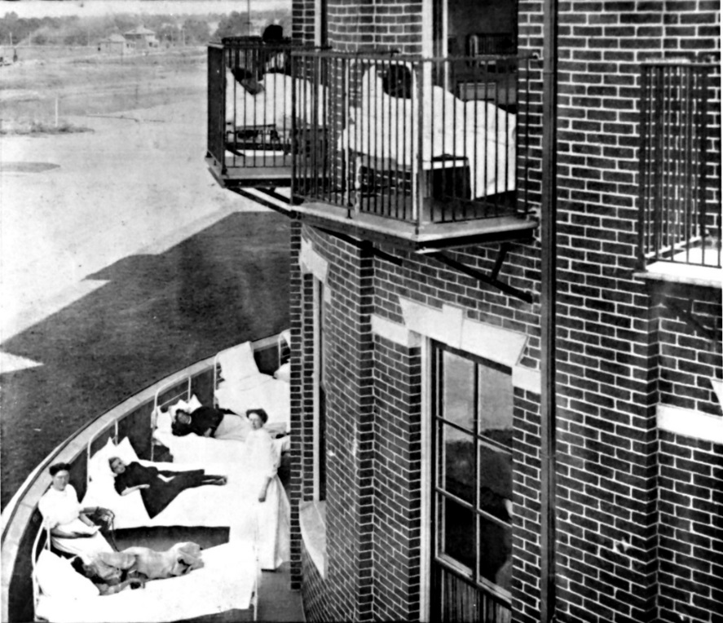
1900s
Patients on the veranda
and sleeping porches

Slide 8
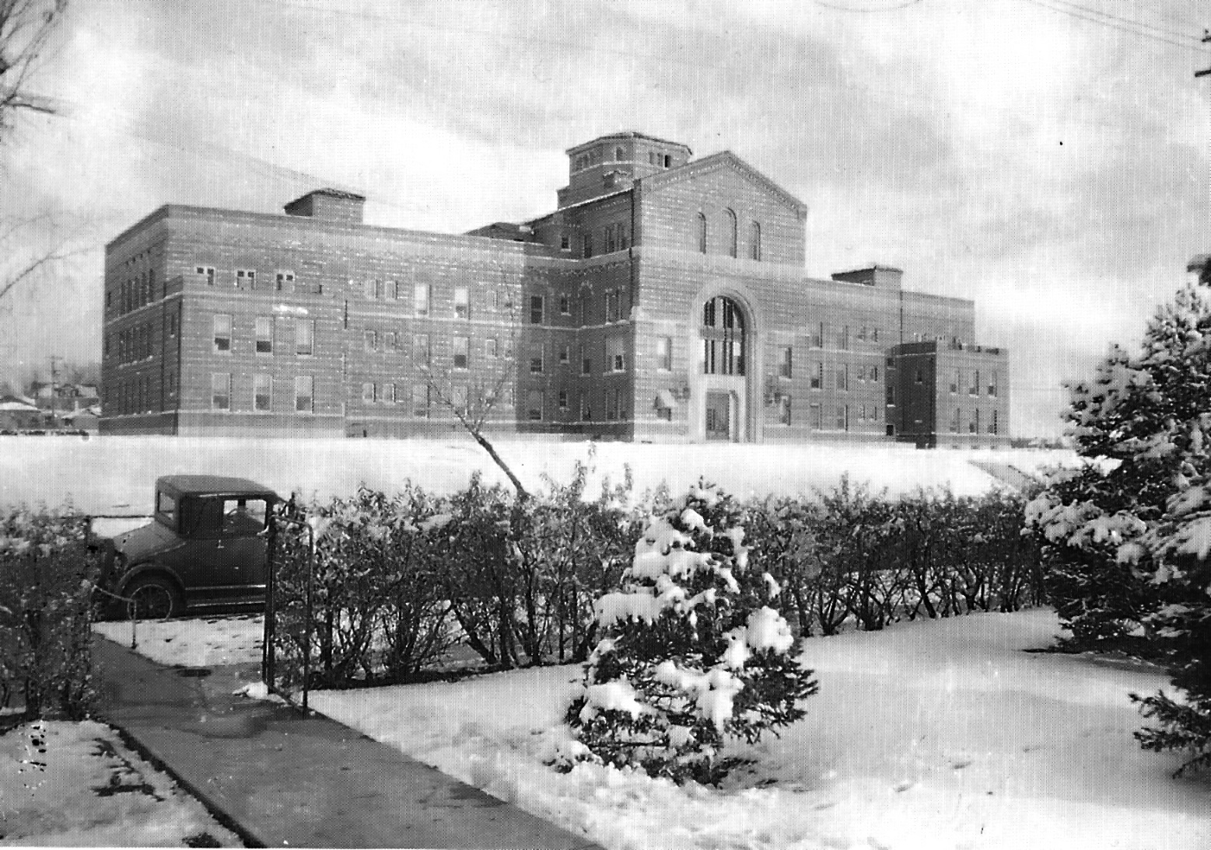
1930s
The B’nai B’rith Infirmary Building bears the motto:
“None may enter who can pay, none can pay who enter.”

Slide 9
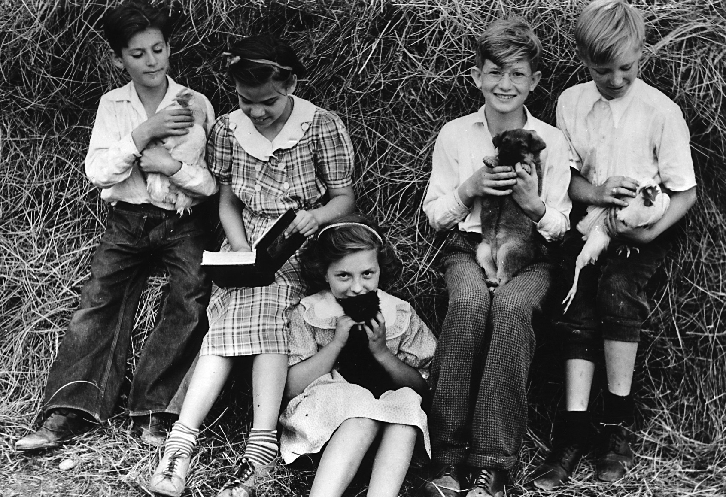
1940s
Pediatric patients and pets at the
National Home for Asthmatic Children

Slide 10
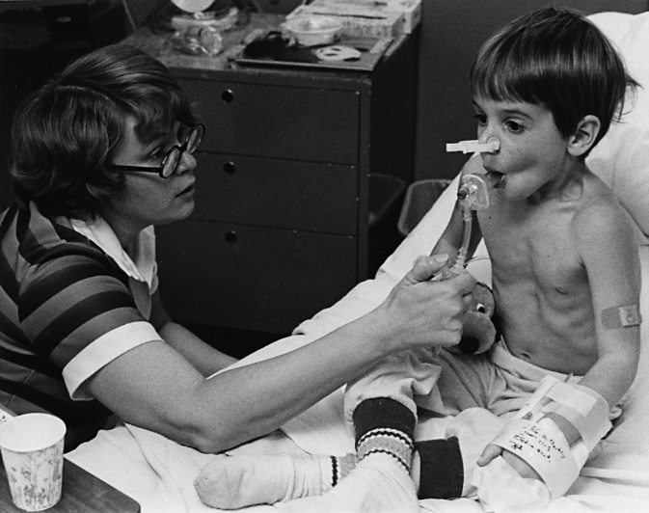
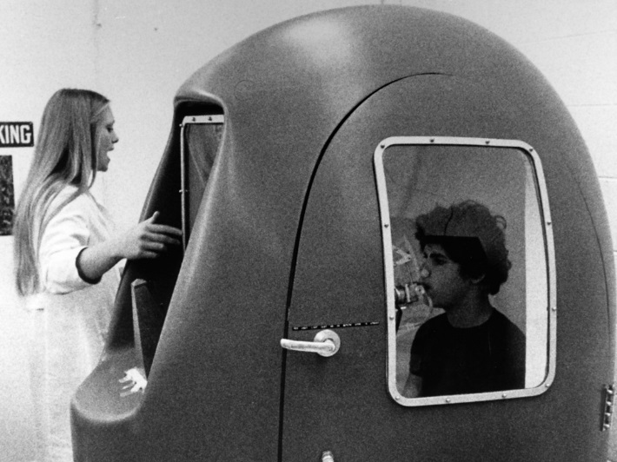
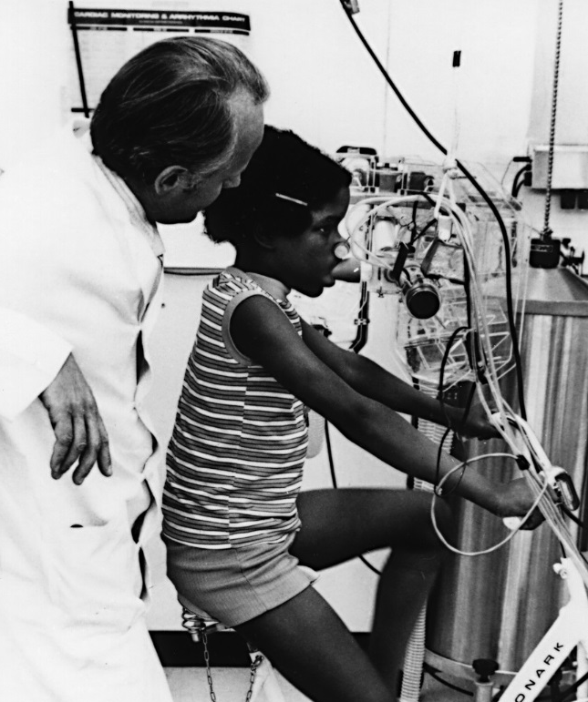
National Jewish Health
1960s
Early pulmonary function testing

Slide 11
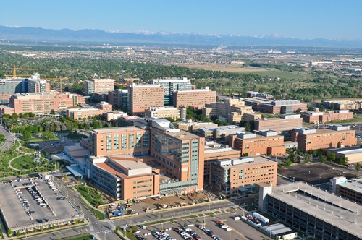
University of Colorado:
Anschutz Medical Center

Slide 12
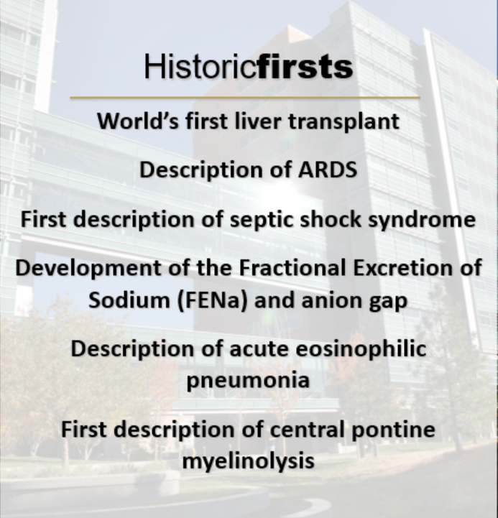
University of Colorado Hospital

Slide 13
Our Faculty
Notes:
Keep it brief. Make your text as brief as possible to maintain a larger font size.

Slide 14
Our Faculty Continued
Notes:
Keep it brief. Make your text as brief as possible to maintain a larger font size.

Slide 15
Our Faculty Continued

Slide 16
Clinical: 75% First Year
25% Second Year
Adult Training at NJH
First and Second Years
Adult Training at UCH First Year
Pediatric Training First and Second Years
Various clinics with Adult Allergy clinicians 1st Year
Continuity Clinic both yrs
Out of State patients
Required Clinical Rotations 1st Year
Various clinics with Adult Allergy clinicians
Immunodeficiency clinic
Group clinic with Private Practice attendings
Inpatient consults
Various clinics with Pediatric Allergy clinicians both years
One month rotation on the Pediatric Unit 2nd Year
EoE Clinic at The Children’s Hospital Colorado 2nd Year
Pediatric Immunodeficiency clinic/ small group teaching
Notes:
Use a section header for each of the topics, so there is a clear transition to the audience.

Slide 17
First Year Schedule: 75% Clinical
Same 3 Rotations (each two months long) Fall and Spring
 |  | University Fellow - 8 weeks
 |  | Monday | Tuesday | Wednesday | Thursday | Friday
8-Noon | AM | Research | Kirkpatrick | Peds - Dr. Boguniewicz | University Clinical Faculty Clinic | Research
1-5 pm | PM | Stitt | NJC - CC | Immune Deficiency/Clinical Lab/Research | Kalra | Research
 |  | Fellow #1 NJC - 8 weeks
 |  | Monday | Tuesday | Wednesday | Thursday | Friday
8-Noon | AM | Hoyte | ENT/ Research | Peds - Santos | University Clinical Faculty Clinic | Hoyte
1-5 pm | PM | Katial | NJC - CC | Immune Deficiency/Clinical Lab/Research | Derm/Research | Consults
 |  | Fellow #2 NJC - 8 weeks
 |  | Monday | Tuesday | Wednesday | Thursday | Friday
8-Noon | AM | Alam | Peds- Rabinovitch | Allergy Tech/PPU | University Clinical Faculty Clinic | Wang
1-5 pm | PM | Rheum /Research | NJC - CC | Immune Deficiency/Clinical Lab/Research | Otsu | Research
Notes:
Summarize presentation content by restating the important points from the lessons.
What do you want the audience to remember when they leave your presentation?
Save your presentation to a video for easy distribution (To create a video, click the File tab, and then click Share. Under File Types, click Create a Video.)

Slide 18
First Year Schedule
Same 3 Rotations (each two months long) Fall and Spring
 |  | University Fellow
 |  | Monday | Tuesday | Wednesday | Thursday | Friday
8-Noon | AM | Research | Kirkpatrick | Peds - Dr. Boguniewicz | University Clinical Faculty Clinic | Research
1-5 pm | PM | Stitt | NJC - CC | Immune Deficiency/Clinical Lab/Research | Kalra | Research
 |  | Fellow #1 NJC
 |  | Monday | Tuesday | Wednesday | Thursday | Friday
8-Noon | AM | Hoyte | ENT/ Research | Peds - Santos | University Clinical Faculty Clinic | Hoyte
1-5 pm | PM | Katial | NJC - CC | Immune Deficiency/Clinical Lab/Research | Derm/Research | Consults
 |  | Fellow #2 NJC
 |  | Monday | Tuesday | Wednesday | Thursday | Friday
8-Noon | AM | Alam | Peds- Rabinovitch | Allergy Tech/PPU | University Clinical Faculty Clinic | Wang
1-5 pm | PM | Rheum /Research | NJC - CC | Immune Deficiency/Clinical Lab/Research | Otsu | Research
Notes:
Summarize presentation content by restating the important points from the lessons.
What do you want the audience to remember when they leave your presentation?
Save your presentation to a video for easy distribution (To create a video, click the File tab, and then click Share. Under File Types, click Create a Video.)

Slide 19
First Year Schedule
Same 3 Rotations (each two months long) Fall and Spring
 |  | University Fellow
 |  | Monday | Tuesday | Wednesday | Thursday | Friday
8-Noon | AM | Research | Kirkpatrick | Peds - Dr. Boguniewicz | University Clinical Faculty Clinic | Research
1-5 pm | PM | Stitt | NJC - CC | Immune Deficiency/Clinical Lab/Research | Kalra | Research
 |  | Fellow #1 NJC
 |  | Monday | Tuesday | Wednesday | Thursday | Friday
8-Noon | AM | Hoyte | ENT/ Research | Peds - Santos | University Clinical Faculty Clinic | Hoyte
1-5 pm | PM | Katial | NJC - CC | Immune Deficiency/Clinical Lab/Research | Derm/Research | Consults
 |  | Fellow #2 NJC
 |  | Monday | Tuesday | Wednesday | Thursday | Friday
8-Noon | AM | Alam | Peds- Rabinovitch | Allergy Tech/PPU | University Clinical Faculty Clinic | Wang
1-5 pm | PM | Rheum /Research | NJC - CC | Immune Deficiency/Clinical Lab/Research | Otsu | Research
Notes:
Summarize presentation content by restating the important points from the lessons.
What do you want the audience to remember when they leave your presentation?
Save your presentation to a video for easy distribution (To create a video, click the File tab, and then click Share. Under File Types, click Create a Video.)

Slide 20
First Year Schedule
Same 3 Rotations (each two months long) Fall and Spring
 |  | University Fellow
 |  | Monday | Tuesday | Wednesday | Thursday | Friday
8-Noon | AM | Research | Kirkpatrick | Peds - Dr. Boguniewicz | University Clinical Faculty Clinic | Research
1-5 pm | PM | Stitt | NJC - CC | Immune Deficiency/Clinical Lab/Research | Kalra | Research
 |  | Fellow #1 NJC
 |  | Monday | Tuesday | Wednesday | Thursday | Friday
8-Noon | AM | Hoyte | ENT/ Research | Peds - Santos | University Clinical Faculty Clinic | Hoyte
1-5 pm | PM | Katial | NJC - CC | Immune Deficiency/Clinical Lab/Research | Derm/Research | Consults
 |  | Fellow #2 NJC
 |  | Monday | Tuesday | Wednesday | Thursday | Friday
8-Noon | AM | Alam | Peds- Rabinovitch | Allergy Tech/PPU | University Clinical Faculty Clinic | Wang
1-5 pm | PM | Rheum /Research | NJC - CC | Immune Deficiency/Clinical Lab/Research | Otsu | Research
Notes:
Summarize presentation content by restating the important points from the lessons.
What do you want the audience to remember when they leave your presentation?
Save your presentation to a video for easy distribution (To create a video, click the File tab, and then click Share. Under File Types, click Create a Video.)

Slide 21
Required Clinical Rotations
Otolaryngology (both rhinology and laryngology)
Dermatology (including patch testing experience)
Rheumatology
Pulmonary Physiology
Allergy Tech (testing, injections)
Clinical Laboratory
Speech Therapy
Allergy Shot Mixing

Slide 22
Second Year Schedule: 25% Clinical
Weekly adult continuity clinic
Weekly pediatric clinic
  6 new attending physicians
  Multidisciplinary EoE clinic at Children’s
Month-long pediatric care unit rotation
Pediatric and adult procedures
Pediatric Immunodeficiency Clinic/ small group teaching
Occupational medicine exposure
Shot dosing/reaction coverage
Patch test experience at UCH
Notes:
Summarize presentation content by restating the important points from the lessons.
What do you want the audience to remember when they leave your presentation?
Save your presentation to a video for easy distribution (To create a video, click the File tab, and then click Share. Under File Types, click Create a Video.)

Slide 23
Research/Scholarly Activities:
25% First Year
75% Second Year
Basic Science Research
Mouse and/or human research
Clinical/Translational Research
Internal, industry, foundation, or federal funding.
Opportunities for Publication
Original and review articles; Book chapters.
Notes:
Use a section header for each of the topics, so there is a clear transition to the audience.

Slide 24
First Year Schedule: 75% Clinical
Same 3 Rotations (each two months long) Fall and Spring
 |  | University Fellow
 |  | Monday | Tuesday | Wednesday | Thursday | Friday
8-Noon | AM | Research | Kirkpatrick | Peds - Dr. Boguniewicz | University Clinical Faculty Clinic | Research
1-5 pm | PM | Stitt | NJC - CC | Immune Deficiency/Clinical Lab/Research | Kalra | Research
 |  | Fellow #1 NJC
 |  | Monday | Tuesday | Wednesday | Thursday | Friday
8-Noon | AM | Hoyte | ENT/ Research | Peds - Santos | University Clinical Faculty Clinic | Hoyte
1-5 pm | PM | Katial | NJC - CC | Immune Deficiency/Clinical Lab/Research | Derm/Research | Consults
 |  | Fellow #2 NJC
 |  | Monday | Tuesday | Wednesday | Thursday | Friday
8-Noon | AM | Alam | Peds- Rabinovitch | Allergy Tech/PPU | University Clinical Faculty Clinic | Wang
1-5 pm | PM | Rheum /Research | NJC - CC | Immune Deficiency/Clinical Lab/Research | Otsu | Research
Notes:
Summarize presentation content by restating the important points from the lessons.
What do you want the audience to remember when they leave your presentation?
Save your presentation to a video for easy distribution (To create a video, click the File tab, and then click Share. Under File Types, click Create a Video.)

Slide 25
Second Year:
75% Research/Scholarly Activities
Mentored research project(s)
Publishing opportunities
Self-paced online biostatistics course
UCH graduate school immunology course

Slide 26
Third Year Research
Research
Continuation of Fellow Research Project and Academic Mentoring.
Status
You would remain a Fellow with GME benefits and status.
ABI Board Exam
You are eligible to take the ABAI Board Exam after second year.
Notes:
Use a section header for each of the topics, so there is a clear transition to the audience.

Slide 27
Colorado Clinical & Translational Sciences Institute Opportunities
Funding Opportunities
KL2 (K12) Research Scholar Award. A mentored award for training early-career MDs, PhDs, DDSs, PharmDs, and DOs as Clinical-Translational researchers.
Translational Informatics
Applies information science to help turn research data into knowledge
Education
Knowledge, training, and career skills such as a biostatistics course, regulatory training, mentoring program.
Notes:
Use a section header for each of the topics, so there is a clear transition to the audience.

Slide 28
Didactics
Orientation lecture series
Tuesday AM conference (formal cases, informal cases, research presentations, M&M)
Wednesday AM Denver Allergy Rounds
Weekly to twice weekly Board Review
Weekly traditional journal club for first years
Monthly evening topic-based journal clubs
Monthly Colorado Allergy Asthma Society dinners
UCH Graduate School Immunology Course for second years
Optional Internal Medicine Grand Rounds/Case Conferences
Optional pediatric program didactic sessions

Slide 29
Fellow/Faculty Publications
(past 10 years – fellow names in bold)
Book Chapters:
Hoyte, FCL, Nelson HS, Kwiat C. Diagnosis of Allergy & Asthma: Allergy Skin Testing, Nasal Provocation challenge, Nasal Eosinophils, Sputum Eosinophils, Peripheral Eosinophils, s IgE. In Diagnostic & Therapeutic Procedures in Allergy. In Press.
Wang E, Bindon B, Zahid S. Biological Therapy. In Diagnostic & Therapeutic Procedures in Allergy. In Press.
Hoyte FCL, Gross LM, Katial RK. Exhaled Nitric Oxide: An Update. Immunol Allergy Clin North Am. 2018 Nov;38(4):573-585.
Wang E, Barberis N, Katial RK. Management of Severe Asthma is Adults: New Insights, In Szefler SJ et al. Personalizing Asthma Management for the Clinician. St, Louis, MO. Elsevier. 2018. 3:19-32
Hill J, Burnett T, Katial RK. Mechanisms of Benefit with Aspirin Therapy. Immunol Allergy Clin North Am. 2016 Nov;36(4):735-747
Notes:
Summarize presentation content by restating the important points from the lessons.
What do you want the audience to remember when they leave your presentation?
Save your presentation to a video for easy distribution (To create a video, click the File tab, and then click Share. Under File Types, click Create a Video.)

Slide 30
Fellow/Faculty Publications
Book Chapters Continued:
Wang E, Hoyte FC. Traditional Therapies for Severe Asthma. Immunol Allergy Clin North Am. 2016 Aug;36(3):581-608.
Dunn NM, Katial RK. Chronic Rhinosinusitis and Aspirin-Exacerbated Respiratory Disease. Immunol Allergy Clin North Am. 2016 Aug;36(3):503-14.
Finkas L, Katial R. Rhinitis. In Scholes MA, Ramakrishnan VR eds. ENT Secrets 4th Edition. Philadelphia, PA: Elsevier. June 2015;167-172.
Burnett T, Katial R, Alam R. Mechanisms of Aspirin Desensitization. In Stevenson DD and Kowalski ML eds. Immunology and Allergy Clinics of North America. Issue: Reactions to Aspirin and other Non-steroidal Anti-inflammatory Drugs. Philadelphia, PA: Elsevier. 2013 May; 33(2):223-36.
Hoyte, FCL, Katial RK. Antihistamine therapy in allergic rhinitis. In Kaliner M ed. Immunology and Allergy Clinics of North America. Issue: Rhinitis. Philadelphia, PA: Elsevier. 2011Aug; 31(3):509-43.

Slide 31
Fellow/Faculty Publications
Original Publications:
Gross L, Nelson HS, Hoyte F. Curcumin does not significantly affect immediate skin tests. Allergy and Asthma Proceedings. In Press.
Wang E, Zahid S, Moudgal AN, Demaestri S, Wamboldt FS. Intimate partner violence and asthma in pediatric and adult populations. Ann Allergy Asthma Immunol. 2022 Apr;128(4):361-
Hazebrouck S, Canon N, Dreskin SC. The Effector Function of Allergens.Front Allergy. 2022 Feb 7;3:818732.
Kirkpatrick CH, Pirzad A. Case report: Prevention of apheresis reactions with icatibant. J Allergy Clin Immunol Pract. 2021 Apr;9(4):1734-1735.
Verma M, Michalec L, Sripada A, McKay J, Sirohi K, Verma D, Sheth D, Martin R, Dyjack N, Seibold MA, Knapp JR, Tu TH, O'Connor BP, Gorska MM, Alam R. The molecular and epigenetic mechanisms of innate lymphoid cell (ILC) memory and its relevance for asthma. J Exp Med. 2021 Jul 5;218(7):e20201354.

Slide 32
Fellow/Faculty Publications
Original Publications Continued:
Buchanan CE, Kakkar E, Dreskin SC, Allen LA, Groves DW, Altman NL. Allergy and the Heart: Eosinophilic Myocarditis With Biventricular Thrombi. JACC Case Rep. 2020 Oct 7;2(12):1942-1946.
Doroudchi A, Pathria M, Modena BD. Asthma biologics: Comparing trial designs, patient cohorts and study results. Ann Allergy Asthma Immunol. 2020 Jan;124(1):44-56.
Gross L, Weber R, Wolf M, Crooks JL. The impact of weather and climate on pollen concentrations in Denver, Colorado, 2010-2018. Ann Allergy Asthma Immunol. 2019 Nov;123(5):494-502.e4
Katial RK, Martucci M, Burnett T, Faino A, Finkas L, Liu S, Alam R. Nonsteroidal anti-inflammatory-induced inhibition of signal transducer and activator of transcription 6 (STAT-6) phosphorylation in aspirin-exacerbated respiratory disease. J Allergy Clin Immunol. 2016 Aug;138(2):579-85.
Notes:
Summarize presentation content by restating the important points from the lessons.
What do you want the audience to remember when they leave your presentation?
Save your presentation to a video for easy distribution (To create a video, click the File tab, and then click Share. Under File Types, click Create a Video.)

Slide 33
Fellow/Faculty Publications
Original Publications:
Dunn NM, Katial RK, Hoyte FCL. Vocal Cord Dysfunction: A Review. Asthma Research and Practice. 2015 Sept; 1-9.
Germinaro M, Reynolds P, Knight V, Alam R. Association of B-cell activating factor receptor deficiency with the P21R polymorphism and common variable immunodeficiency. Ann Allergy Asthma Immunol. 2015 Jul;115(1):82-3.
Stitt JM, Dreskin SC. The potential role of omalizumab in the treatment of chronic urticaria. Immunotherapy. 2014 Jun;6(6):691-7.
Chen Z, Wang S, Erekosima N, Li Y, Hong J, Qi X, Merkel P, Nagabhushanam V, Choo E, Katial R, Alam R, Trikha A, Chu HW, Zhuang Y, Jin M, Bai C, Huang H. IL-4 confers resistance to IL-27-mediated suppression on CD4(+) T cells by impairing signal transducer and activator of transcription 1 signaling. J Allergy Clin Immunol. 2013 Oct;132(4):912-921.
Notes:
Summarize presentation content by restating the important points from the lessons.
What do you want the audience to remember when they leave your presentation?
Save your presentation to a video for easy distribution (To create a video, click the File tab, and then click Share. Under File Types, click Create a Video.)

Slide 34
Fellow/Faculty Publications
Original Publications Continued:
Stitt JM, Dreskin SC. Urticaria and autoimmunity: where are we now? Curr Allergy Asthma Rep. 2013 Oct;13(5):555-62.
Otsu K, Dreskin SC. Peanut Allergy: An evolving clinical challenge. Discov Med. 2012: 12(65): 319-328.
Ostroukhova M, Goplen N, Guo L, Liang Q and Alam R. The role of low-level lactate production in airway inflammation in asthma. Am. J. Physiol. Lung Cell. Mol. Physiol. 2012;302:L300-7.
Martucci MA, Dreskin SC. Immunologic Similarities Between Selected Autoimmune Diseases and Peanut Allergy: Possible New Therapeutic Approaches. Curr Allergy and Asthma Rep. 2011;11:334-339.
Notes:
Summarize presentation content by restating the important points from the lessons.
What do you want the audience to remember when they leave your presentation?
Save your presentation to a video for easy distribution (To create a video, click the File tab, and then click Share. Under File Types, click Create a Video.)

Slide 35
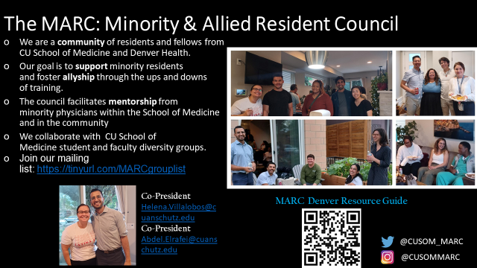
Minority & Allied Resident Council

Slide 36
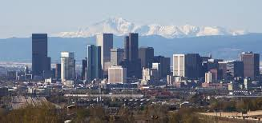
Living in Denver
Denver Metro Area: population 2.8 million
Recently named #1 U.S. city for young professionals
Diverse neighborhoods within driving distance of both hospitals
Denver International Airport: major hub

Slide 37

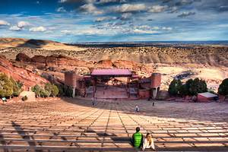
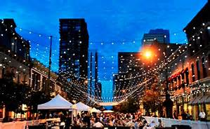
Living in Denver
Home to 6 professional sports teams (Broncos, Nuggets, Avalanche, Rapids, Rockies, Mammoth)
Performing arts: symphony, opera, theater, dance, red rocks amphitheatre
Many cultural attractions and events
Great restaurants
Wide array of city parks and bike trails

Slide 38
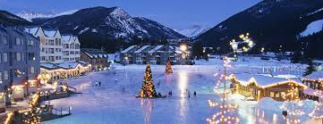
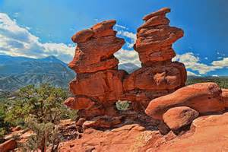
Living in Denver
Multiple ski resorts within 2 hrs
Sights within driving distance
  Mount Evans
  Pike’s Peak
  Garden of the Gods
  Eldorado Canyon State Park
  Rocky Mountain National Park

